Slide 1


Collins
17-07-2023

Slide 2

Outline
Executive Summary
Introduction
Methodology
Results
Conclusion
Appendix

Slide 3
Executive Summary
Summary of methodologies
Summary of all results

Slide 4
Introduction
Project background and context
Problems you want to find answers

Slide 5

Section 1

Slide 6
Methodology
Executive Summary
Data collection methodology:
The data was collected from the SpaceX API
Perform data wrangling
Data was processed in Python
Perform exploratory data analysis (EDA) using visualization and SQL
Perform interactive visual analytics using Folium and Plotly Dash
Perform predictive analysis using classification models
How to build, tune, evaluate classification models

Slide 7
Data Collection
Describe how data sets were collected.
SpaceX data sets were collected through various methods including telemetry, sensor measurements, on-board cameras, and ground-based tracking systems during their space missions and rocket launches.
You need to present your data collection process use key phrases and flowcharts

Slide 8
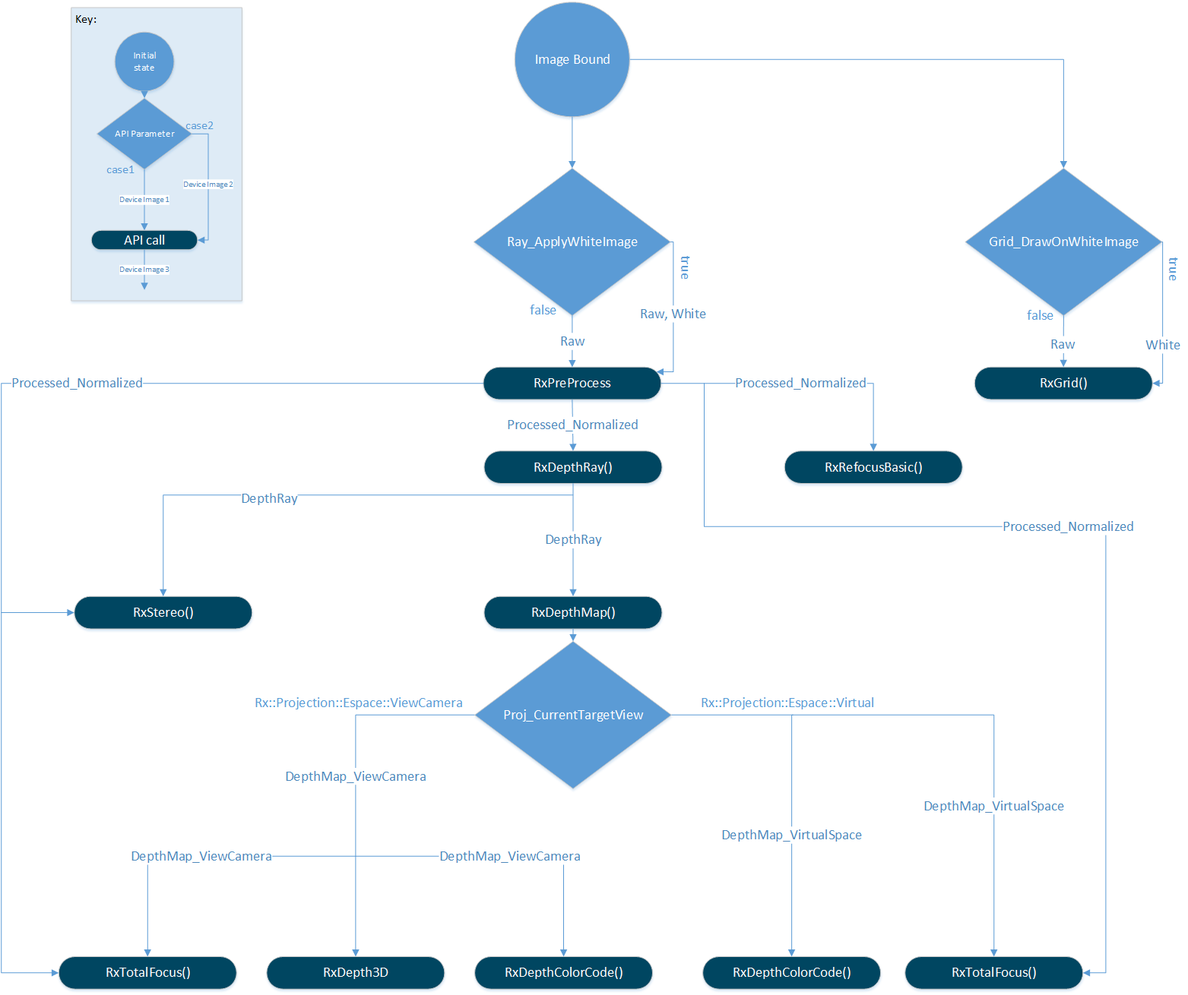
Data Collection – SpaceX API
Present your data collection with SpaceX REST calls using key phrases and flowcharts
Github.com/datacollins

Slide 9
Data Collection - Scraping
Present your web scraping process using key phrases and flowcharts
Github.com/datacollins
Place your flowchart of web scraping here

Slide 10
Data Wrangling
Describe how data were processed
The collected SpaceX data underwent processing through algorithms and data analysis techniques to extract relevant information, identify patterns, and derive insights, enabling the company to improve mission performance, rocket design, and overall operational efficiency.
Additionally, machine learning and artificial intelligence algorithms were employed to optimize data processing, enhance anomaly detection, and support decision-making processes for future space missions.
You need to present your data wrangling process using key phrases and flowcharts
Add the GitHub URL of your completed data wrangling related notebooks, as an external reference and peer-review purpose

Slide 11
EDA with Data Visualization
Summarize what charts were plotted and why you used those charts
Various charts were plotted using SpaceX data, including trajectory plots, payload capacity charts, and engine performance graphs, among others. These charts were utilized to visualize and analyze crucial aspects of SpaceX operations, such as rocket flight paths, payload capabilities, and engine efficiency, enabling better understanding and optimization of their space missions.
Add the GitHub URL of your completed EDA with data visualization notebook, as an external reference and peer-review purpose github.com/datacollins

Slide 12
EDA with SQL
Using bullet point format, summarize the SQL queries you performed
- Executed SELECT queries to retrieve specific columns from tables.
- Utilized JOIN operations to combine data from multiple tables based on specified relationships.
- Employed WHERE clauses to filter data based on specific conditions.
- Used GROUP BY clauses to group data and perform aggregate functions like SUM, AVG, and COUNT.
Implemented ORDER BY clauses to sort data in ascending or descending order.

Slide 13
Build an Interactive Map with Folium
Summarize what map objects such as markers, circles, lines, etc. you created and added to a folium map
Various map objects, including markers, circles, lines, and polygons, were created and added to a Folium map. These objects were used to represent and visualize specific geographical points of interest, areas of coverage, routes, and boundaries, enhancing the overall map visualization and providing meaningful spatial information.
Explain why you added those objects
To make the data more interesting and easier to understand

Slide 14
Build a Dashboard with Plotly Dash
Summarize what plots/graphs and interactions you have added to a dashboard
In the dashboard, several plots and graphs, such as bar charts, line charts, scatter plots, and pie charts, were incorporated to display and compare data trends, distributions, and relationships. Interactive features like filters, dropdown menus, and hover tooltips were implemented to enable user-driven exploration, data filtering, and dynamic visualization customization within the dashboard.
Explain why you added those plots and interactions
The plots and interactions were added to the dashboard to provide a visually appealing and informative representation of the data. They enable users to easily grasp data trends, distributions, and relationships, facilitating better decision-making and understanding of the underlying information. The interactive features enhance user engagement by allowing them to explore and interact with the data, enabling customized views and dynamic analysis based on specific interests or requirements.

Slide 15
Predictive Analysis (Classification)
Summarize how you built, evaluated, improved, and found the best performing classification model
The classification model was built using a suitable algorithm, such as logistic regression or random forest, trained on labeled data and evaluated using metrics like accuracy, precision, recall, and F1 score. Iterative improvements were made by adjusting hyperparameters, exploring different feature engineering techniques, and employing cross-validation methods until the best performing model was identified based on its evaluation metrics.
You need present your model development process using key phrases and flowchart

Slide 16
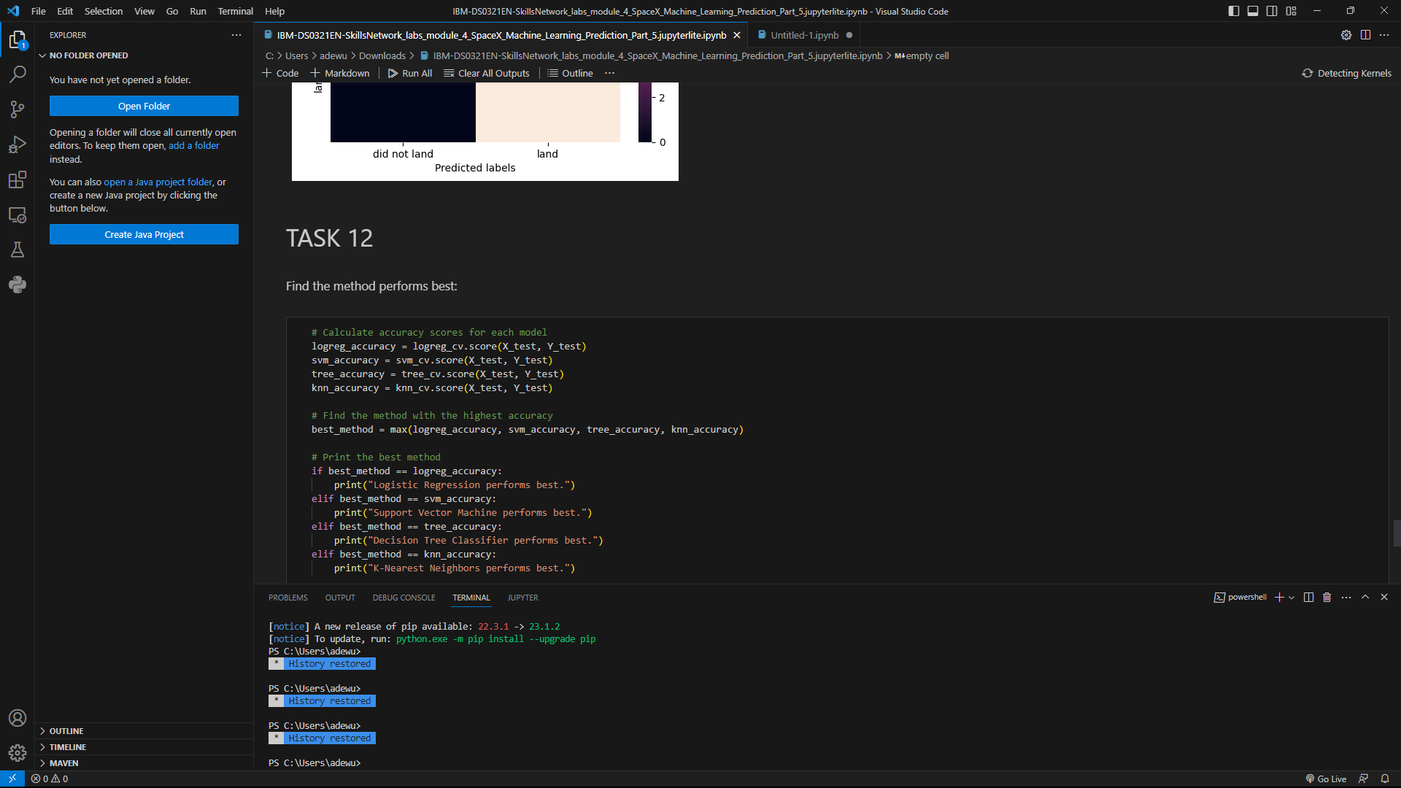
Results
Exploratory data analysis results- In the screenshot attached
Interactive analytics demo in screenshots
Predictive analysis results

Slide 17

Section 2

Slide 18
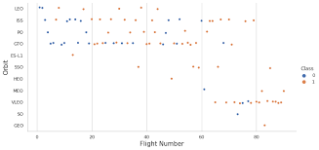
Flight Number vs. Launch Site
Show a scatter plot of Flight Number vs. Launch Site
Show the screenshot of the scatter plot with explanations

Slide 19
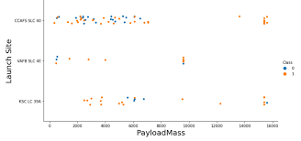
Payload vs. Launch Site
Show a scatter plot of Payload vs. Launch Site
Show the screenshot of the scatter plot with explanations

Slide 20
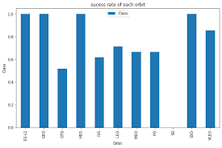
Success Rate vs. Orbit Type
Show a bar chart for the success rate of each orbit type
Show the screenshot of the scatter plot with explanations

Slide 21
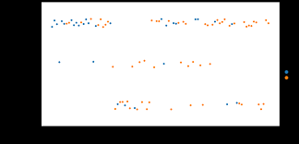
Flight Number vs. Orbit Type
Show a scatter point of Flight number vs. Orbit type
Show the screenshot of the scatter plot with explanations

Slide 22
Payload vs. Orbit Type
Show a scatter point of payload vs. orbit type
Show the screenshot of the scatter plot with explanations

Slide 23
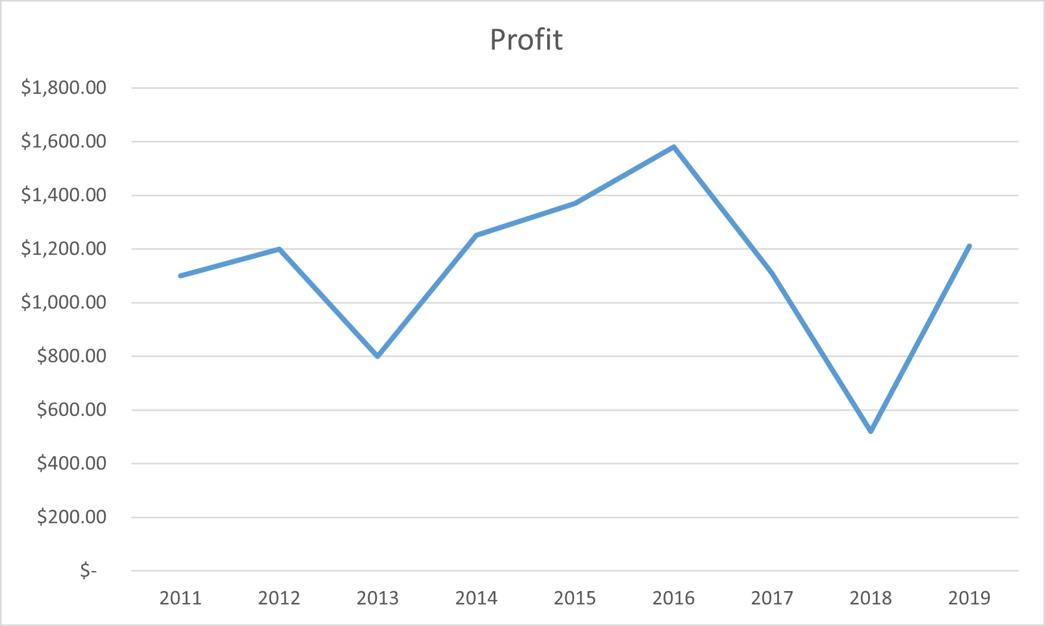
Launch Success Yearly Trend
Show a line chart of yearly average success rate
Show the screenshot of the scatter plot with explanations

Slide 24
All Launch Site Names
Find the names of the unique launch sites
Present your query result with a short explanation here
SELECT DISTINCT launch_site_name
FROM launch_data;
The above query provides the distinct name of each of the launch sites, that is, no matter how many times a launch site appears, it won’t be listed more than once.

Slide 25
Launch Site Names Begin with 'CCA'
Find 5 records where launch sites begin with `CCA`
Present your query result with a short explanation here
cur.execute("SELECT launch_site FROM missions WHERE launch_site LIKE 'CCA%' LIMIT 5")
# Fetch the results
launch_sites = cur.fetchall()
# Display the launch sites
for site in launch_sites:
print(site[0])
# Close the database connection
con.close()

Slide 26
Total Payload Mass
Calculate the total payload carried by boosters from NASA
Present your query result with a short explanation here
# Execute the SQL query to calculate the total payload mass
cur.execute("SELECT SUM(payload_mass) FROM missions WHERE agency='NASA' AND booster='CRS'")
# Fetch the total payload mass
total_payload_mass = cur.fetchone()[0]
# Display the total payload mass
print("Total payload mass carried by NASA CRS boosters:", total_payload_mass)
# Close the database connection
con.close()

Slide 27
Average Payload Mass by F9 v1.1
Calculate the average payload mass carried by booster version F9 v1.1
Present your query result with a short explanation here
# Execute the SQL query to calculate the average payload mass
cur.execute("SELECT AVG(payload_mass) FROM missions WHERE booster_version='F9 v1.1'")
# Fetch the average payload mass
average_payload_mass = cur.fetchone()[0]
# Display the average payload mass
print("Average payload mass carried by F9 v1.1 booster:", average_payload_mass)
# Close the database connection
con.close()

Slide 28
First Successful Ground Landing Date
Find the dates of the first successful landing outcome on ground pad
Present your query result with a short explanation here

Slide 29
Successful Drone Ship Landing with Payload between 4000 and 6000
List the names of boosters which have successfully landed on drone ship and had payload mass greater than 4000 but less than 6000
Present your query result with a short explanation here
cur.execute("SELECT MIN(date) FROM missions WHERE landing_outcome='Success' AND landing_type='Ground Pad'")
# Fetch the result
first_successful_landing_date = cur.fetchone()[0]
# Display the first successful landing date
print("Date of the first successful landing outcome on a ground pad:", first_successful_landing_date)
# Close the database connection
con.close()

Slide 30
Total Number of Successful and Failure Mission Outcomes
Calculate the total number of successful and failure mission outcomes
Present your query result with a short explanation here
cur.execute("SELECT COUNT(*) FROM missions WHERE mission_outcome='Failure'")
# Fetch the count of failed missions
failure_count = cur.fetchone()[0]
# Display the total number of successful and failure mission outcomes
print("Total successful missions:", successful_count)
print("Total failed missions:", failure_count)
# Close the database connection
con.close()

Slide 31
Boosters Carried Maximum Payload
List the names of the booster which have carried the maximum payload mass
Present your query result with a short explanation here
cur.execute("SELECT booster_version FROM missions WHERE payload_mass = (SELECT MAX(payload_mass) FROM missions)")
# Fetch the results
booster_versions = cur.fetchall()
# Display the names of the booster versions
for version in booster_versions:
print(version[0])
# Close the database connection
con.close()

Slide 32
2015 Launch Records
List the failed landing_outcomes in drone ship, their booster versions, and launch site names for in year 2015
Present your query result with a short explanation here
# Execute the SQL query to retrieve the records
cur.execute("""
SELECT
CASE
WHEN SUBSTR(Date, 4, 2) = '01' THEN 'January'
WHEN SUBSTR(Date, 4, 2) = '02' THEN 'February'
WHEN SUBSTR(Date, 4, 2) = '03' THEN 'March'
WHEN SUBSTR(Date, 4, 2) = '04' THEN 'April'
WHEN SUBSTR(Date, 4, 2) = '05' THEN 'May'
WHEN SUBSTR(Date, 4, 2) = '06' THEN 'June'
WHEN SUBSTR(Date, 4, 2) = '07' THEN 'July'
WHEN SUBSTR(Date, 4, 2) = '08' THEN 'August'
WHEN SUBSTR(Date, 4, 2) = '09' THEN 'September'
WHEN SUBSTR(Date, 4, 2) = '10' THEN 'October'
WHEN SUBSTR(Date, 4, 2) = '11' THEN 'November'
WHEN SUBSTR(Date, 4, 2) = '12' THEN 'December'
END AS Month,
landing_outcome,
booster_version,
launch_site
FROM
missions
WHERE
SUBSTR(Date, 7, 4) = '2015'
AND landing_type = 'Drone Ship'
AND landing_outcome = 'Failure'
""")
# Fetch the results
records = cur.fetchall()
# Display the records
for record in records:
print("Month:", record[0])
print("Landing Outcome:", record[1])
print("Booster Version:", record[2])
print("Launch Site:", record[3])
print()
# Close the database connection
con.close()

Slide 33
Rank Landing Outcomes Between 2010-06-04 and 2017-03-20
Rank the count of landing outcomes (such as Failure (drone ship) or Success (ground pad)) between the date 2010-06-04 and 2017-03-20, in descending order
Present your query result with a short explanation here
cur.execute("""
SELECT landing_outcome, COUNT(*) AS outcome_count
FROM missions
WHERE Date BETWEEN '2010-06-04' AND '2017-03-20'
GROUP BY landing_outcome
ORDER BY outcome_count DESC
""")
# Fetch the results
ranking = cur.fetchall()
# Display the ranking of landing outcomes
for rank, (outcome, count) in enumerate(ranking, start=1):
print(f"Rank {rank}: {outcome} - Count: {count}")
# Close the database connection
con.close()

Slide 34

Section 3

Slide 35
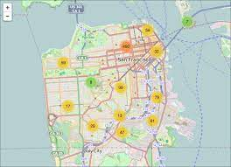
My Map
Replace My Map title with an appropriate title
Explore the generated folium map and make a proper screenshot to include all launch sites’ location markers on a global map
Explain the important elements and findings on the screenshot

Slide 36
My Folium Map
Replace title with an appropriate title
Explore the folium map and make a proper screenshot to show the color-labeled launch outcomes on the map
Explain the important elements and findings on the screenshot

Slide 37
Folium Map
Replace title with an appropriate title
Explore the generated folium map and show the screenshot of a selected launch site to its proximities such as railway, highway, coastline, with distance calculated and displayed
Explain the important elements and findings on the screenshot
The SpaceX map displays key elements such as launch sites, rocket landing locations, and mission trajectories, providing insights into the company's operational footprint, reusability efforts, and successful mission coverage.

Slide 38

Section 4

Slide 39
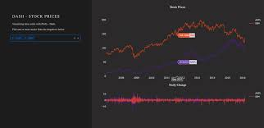
Plotly Dashboard
Replace title with an appropriate title
Show the screenshot of launch success count for all sites, in a piechart
Explain the important elements and findings on the screenshot

Slide 40
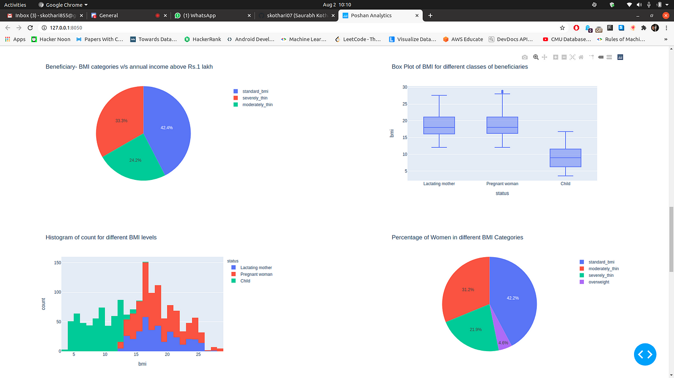
My Plotly Dashboard
Replace title with an appropriate title
Show the screenshot of the piechart for the launch site with highest launch success ratio
Explain the important elements and findings on the screenshot

Slide 41
Plotly Dashboard
Replace title with an appropriate title
Show screenshots of Payload vs. Launch Outcome scatter plot for all sites, with different payload selected in the range slider
Explain the important elements and findings on the screenshot, such as which payload range or booster version have the largest success rate, etc.

Slide 42

Section 5

Slide 43
Classification Accuracy
Visualize the built model accuracy for all built classification models, in a bar chart
Find which model has the highest classification accuracy

Slide 44
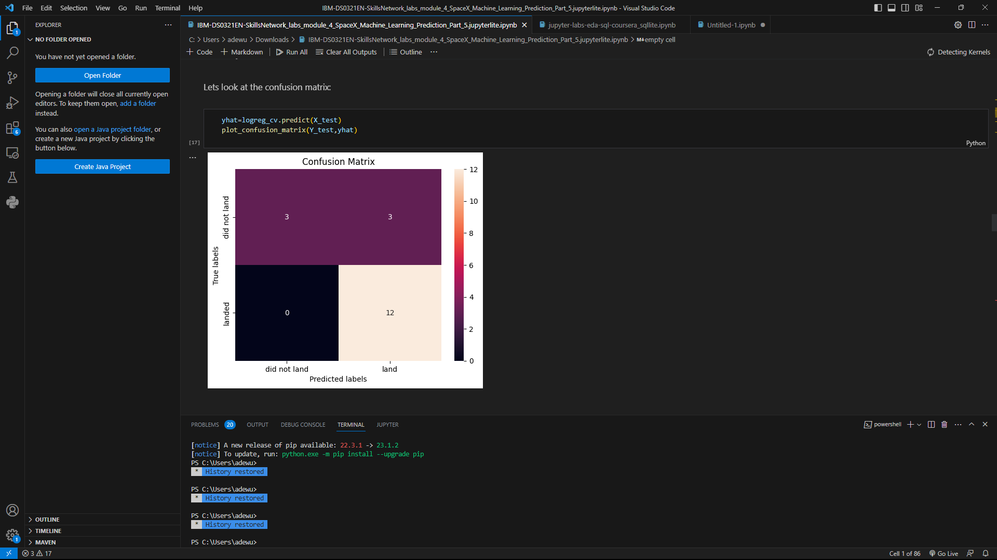
Confusion Matrix
Show the confusion matrix of the best performing model with an explanation

Slide 45
Conclusions
1. SpaceX has achieved significant progress in rocket reusability, as evidenced by the increasing number of successful rocket landings captured in the dataset.
2. The dataset reveals the company's expanding launch capabilities with multiple launch sites being utilized for various missions.
3. Analyzing mission trajectories can provide insights into the destinations and orbits targeted by SpaceX, indicating their involvement in a wide range of space activities.
4. The dataset may uncover trends in payload capacity, demonstrating improvements in rocket design and engineering over time.

Slide 46
Appendix
Include any relevant assets like Python code snippets, SQL queries, charts, Notebook outputs, or data sets that you may have created during this project
- I used just the one provided, no extra.

Slide 47


